Slide 1
Housing Challenges in Rural Interior Alaska
Tanana Chiefs Conference
Tribal Services
Planning & Development Department
March 2018
Contractor: Tillila Beetus/Edwin Bifelt – Zane Hills Capital and ANRI

Slide 2
TCC Rural Community Needs Survey
TCC Rural Community Needs Survey: Sept 2018
Highest Priority Community Needs
Sub-Region | Housing Priority Total | Housing Priority % of all responses
Lower Yukon | 52 | 29.55%
Upper Kuskokwim | 7 | 20.59%
Yukon Koyukuk | 152 | 28.04%
Yukon Tanana | 92 | 33.21%
Yukon Flats | 56 | 22.31%
Upper Tanana | 65 | 35.52%
Total | 424 | 28.96%
September 2018
Survey participants each identified three top priorities in there communities
Housing was the HIGHEST priority from all sub-regions
Housing was higher than the next 3 categories combined
  Jobs/Training
  Public Safety/Substance Abuse
  Patient Travel

Slide 3
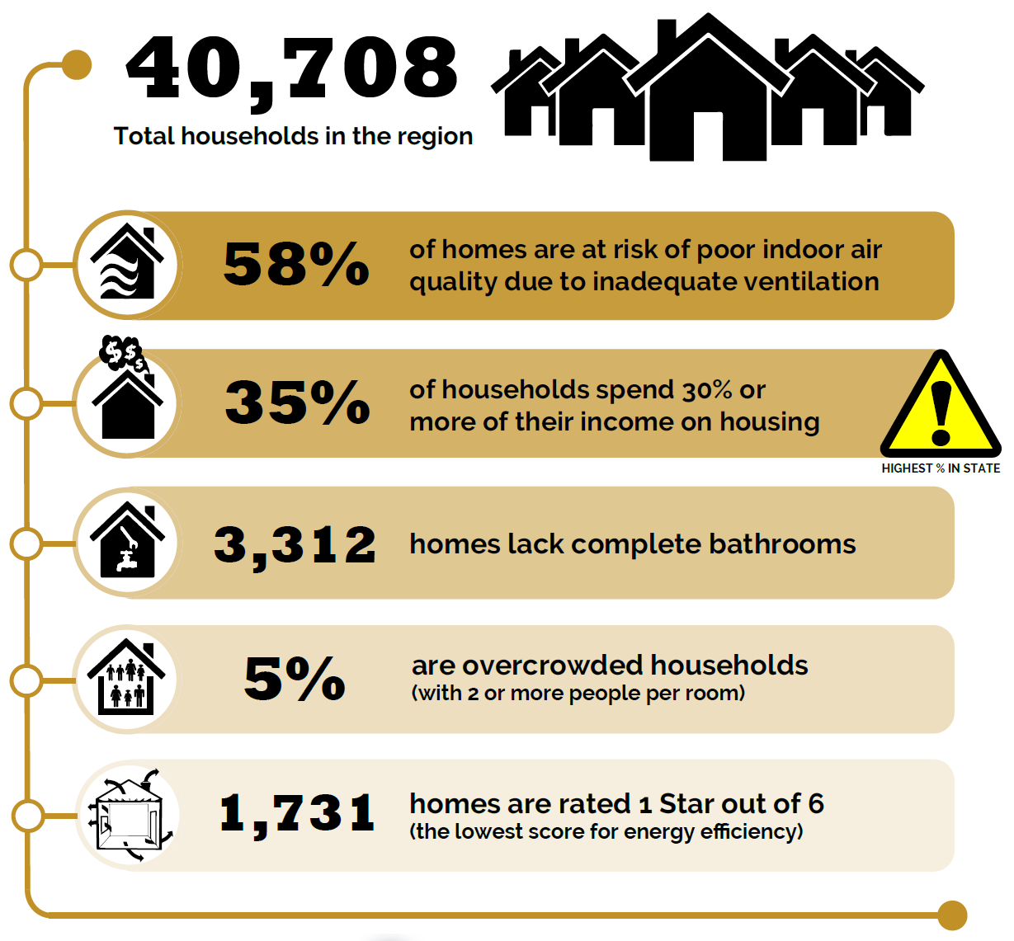
2018 Alaska Housing Assessment
IRHA Region: Key Facts
Report compiled annually by
AHFC and CCHRC.
https://www.ahfc.us/efficiency/research-information-center/alaska-housing-assessment/2018-housing-assessment

Slide 4
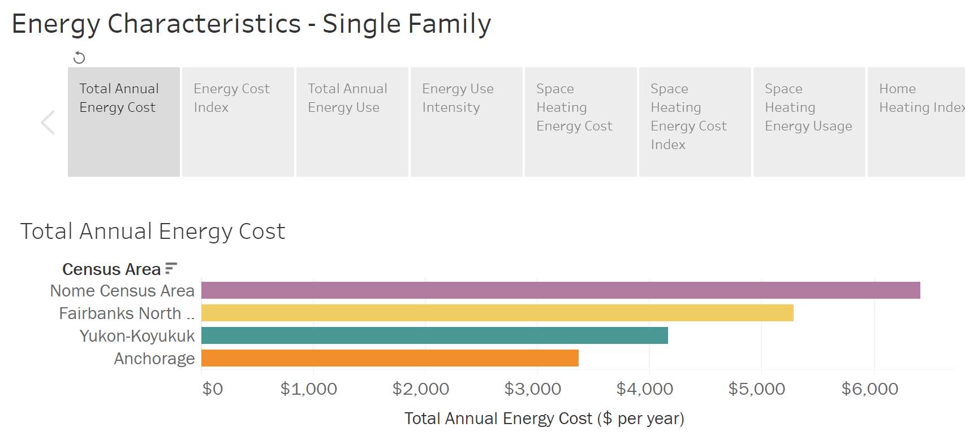
2018 Alaska Housing Assessment
Total Annual Energy Costs
https://www.ahfc.us/efficiency/research-information-center/alaska-housing-assessment/2018-housing-assessment/census-area-energy-characteristics

Slide 5
Infrastructure: How to solve the Water & Sewer challenge?
Makes up a substantial portion of the cost to build in rural Alaska.
Indian Health Services (IHS) has a ‘Proposed Alaska Sanitation Needs’ tracking system
  Sanitation Tracking & Reporting System (STARS)
  most all TCC region communities have projects listed
  https://wstars.ihs.gov/index.cfm?fuseaction=Reports.listSdsProjectsForCommunity
Zane Hills Capital has separated the projects into ‘Piped Water & Sewer’ and ‘Alternative Projects’ Categories
  TOTAL Piped Water & Sewer Est. Cost = $570.24 Million
  TOTAL Alternative Projects Est. Cost = $53.62 Million

Slide 6
Yukon Tanana sub-region
Community | Project Type: Piped W&S | Current Piped W&S | Est. Project Cost |  | Alternative Project | Est. Project Cost
Yukon Tanana
Bettles/Evansville | No Projects Listed | Unknown |  |  | No Projects Listed
Alatna | Comprehensive Piped System | No | $ 20,739,800.00 |  | PASS System (12 homes) & Solid Waste Landfill | $ 1,454,800.00
Allakaket | Comprehensive Piped System | No | $ 62,511,500.00 |  | Water & Sewer Phase 1 (wells/septic system for 20 homes) | $ 3,851,797.00
Hughes | No Projects Listed | Yes |  |  | No Projects Listed
Minto | - | Yes | - |  | Rehab Plumbing/Service Lines (14 homes) | $ 240,000.00
Nenana | - | Yes | - |  | Water Treatment Plant Renovation | $ 4,133,973.00
Manley Hot Springs | No Projects Listed | Unknown |  |  | No Projects Listed
Rampart | - | No |  |  | First Service: Wells/Septic system for 9 homes | $ 1,546,025.00
Tanana | W/S Grid Additions; Circle area=8 homes, and another 5 homes | Yes | $ 8,660,303.00 |  | New Community Water Well and Sewage Lagoon Upgrade | $ 997,328.00
Stevens Village | Comprehensive Piped System | No | $ 42,902,400.00 |  | - | -
 |  |  | $ 134,814,003.00 |  |  | $ 12,223,923.00

Slide 7
Yukon Koyukuk sub-region
Community | Project Type: Piped W&S | Current Piped W&S | Est. Project Cost |  | Alternative Project | Est. Project Cost
Yukon Koyukuk
Galena | W/S Grid Additions; Louden Loop and Antoski Drive | Yes | $ 2,226,475.00 |  | Back-up Community Water Well & Water Treatment Plant Rehab | $ 1,938,000.00
Huslia | - | Yes | - |  | Wells/Septic system for 10 homes | $ 907,044.00
Kaltag | Phase 2 Water & Sewer Upgrade | Yes | $ 5,909,063.00 |  | Washeteria Upgrades | $ 50,000.00
Koyukuk | Comprehensive Piped System | No | $ 29,092,100.00 |  | Wells/Septic system for 20 homes | $ 3,431,098.00
Nulato | W/S Grid Additions; Downtown and West End of Lower Townsite (15 total) | Yes | $ 7,354,219.00 |  | New Solid Waste Site & Repair Leaks at Service Connections | $ 857,025.00
Ruby | - | Yes | - |  | Wells/Septic system for 21 homes and new Community Sludge Disposal Facility | $ 4,609,046.00
 |  |  | $ 44,581,857.00 |  |  | $ 11,792,213.00

Slide 8
Yukon Flats sub-region
Community | Project Type: Piped W&S | Current Piped W&S | Est. Project Cost |  | Alternative Project | Est. Project Cost
Yukon Flats
Arctic Village | Comprehensive Piped System | No | $ 52,318,100.00 |  | - | -
Beaver | Comprehensive Piped System | No | $ 46,206,800.00 |  | Modular Washeteria and Associated Upgrades | $ 2,288,806.00
Birch Creek | Comprehensive Piped System | No | $ 28,351,900.00 |  | Wells/Septic system for 6 homes; Water Intake Rehab | $ 1,388,417.00
Canyon Village | No Projects Listed | Unknown | - |  | No Projects Listed
Chalkyitsik | Comprehensive Piped System | No | $ 38,946,300.00 |  | PASS System for 40 homes; Water Treatment Plant and Washeteria Upgrades | $ 2,902,295.00
Circle | Comprehensive Piped System | No | $ 44,097,900.00 |  | Community Well and Water plant Improvements | $ 590,184.00
Fort Yukon | No Projects Listed | Yes | - |  | No Projects Listed
Venetie | Comprehensive Piped System | No | $ 50,096,700.00 |  | Wells/Septic system for 20 homes | $ 3,819,933.00
 |  |  | $ 260,017,700.00 |  |  | $ 10,989,635.00

Slide 9
Upper Kuskokwim sub-region
Community | Project Type: Piped W&S | Current Piped W&S | Est. Project Cost |  | Alternative Project | Est. Project Cost
Upper Kuskokwim
McGrath | - | Yes | - |  | Lagoon Upgrades & Piped Water Distribution Upgrades | $ 6,013,878.00
Medfra | No Projects Listed | Unknown |  |  | No Projects Listed
Nikolai | - | Yes | - |  | Upgrade plumbing for 15 homes; Solid Waste and Lift Station improvements | $ 3,259,945.00
Takotna | Comprehensive Piped System | No | $ 37,469,500.00 |  | PASS System for 2 homes | $ 103,966.00
Telida | - | Unknown | - |  | Wells/Septic system for 2 homes | $ 240,000.00
 |  |  | $ 37,469,500.00 |  |  | $ 9,617,789.00

Slide 10
Upper Tanana sub-region
Community | Project Type: Piped W&S | Current Piped W&S | Est. Project Cost |  | Alternative Project | Est. Project Cost
Upper Tanana
Dot Lake | No Projects Listed | Unknown | - |  | No Projects Listed | -
Eagle | Comprehensive Piped System | No | $ 26,820,700.00 |  | - | -
Healy Lake | - | Unknown | - |  | Water Plant and Washeteria Repairs | $ 500,000.00
Northway | Comprehensive Piped System | No | $ 16,464,700.00 |  | Solid Waste Landfill upgrades | $ 1,355,229.00
Tanacross | - | Yes | - |  | Replace failed leach field and infiltration | $ 515,000.00
Tetlin | Comprehensive Piped System | No | $ 29,773,800.00 |  | Water/Sewer Haul System for 10 homes; Burn Unit for SW Landfill; New Community Water Well | $ 2,148,945.00
Tok | No Projects Listed | Yes | - |  | - | -
 |  |  | $ 73,059,200.00 |  |  | $ 4,519,174.00

Slide 11
Lower Yukon sub-region
Community | Project Type: Piped W&S | Current Piped W&S | Est. Project Cost |  | Alternative Project | Est. Project Cost
Lower Yukon
Anvik | - | Yes | - |  | Water Plant Renovation and Lagoon Upgrades | $ 2,721,475.00
Grayling | Water Distribution System Upgrades (phase 1); Replacement (Phase 2) | Yes | $ 6,521,043.00 |  | Purchase a Solid Waste Burn Unit | $ 99,303.00
Holy Cross | - | Yes | - |  | New Community Water Well | $ 1,551,744.00
Shageluk | Comprehensive Piped System | No | $ 13,778,380.00 |  | Landfill Upgrades | $ 102,638.00
 |  |  | $ 20,299,423.00 |  |  | $ 4,475,160.00

Slide 12
Region Construction Characteristics
Homebuilders in the region
TCC
IRHA
Tribal Housing Authorities
Homeowners
General Contractors (with Residential Endorsement)
Estimated Average Cost of Construction = $550,000

Slide 13
TCC Region Housing Needs Summary
Current population: 5,363
  Upper Kuskokwim - 455
  Yukon Koyukuk – 1,196
  Yukon Tanana – 1,309
  Yukon Flats – 1,196
  Upper Tanana - 696
  Lower Yukon - 511
Total Housing Demand (current + future): 861
Total built in past 5 years: 85

Slide 14
Upper Kuskokwim
Current population: 455
  McGrath – 295
  Nikolai – 97
  Takotna – 61
  Telida - 2
Total Housing Demand (current + future): 43
Total built in past 5 years: 8

Slide 15
Yukon Koyukuk
Current population: 1,416
  Huslia – 293
  Kaltag – 147
  Koyukuk – 95
  Galena – 472
  Nulato – 239
  Ruby - 170
Total Housing Demand (current + future): 160
Total built in past 5 years: 16

Slide 16
Yukon Tanana
Current population: 1,309
  Alatna – 26
  Allakaket – 164
  Evansville – 10
  Hughes – 95
  Manley Hot Springs – 112
  Minto – 201
  Nenana – 372
  Rampart – 54
  Stevens Village – 50
  Tanana - 225
Total Housing Demand (current + future): 203
Total built in past 5 years: 21

Slide 17
Yukon Flats
Current population: 1,196
  Arctic Village – 189
  Beaver – 63
  Birch Creek – 21
  Circle – 102
  Chalkyitsik – 77
  Fort Yukon – 563
  Venetie - 181
Total Housing Demand (current + future): 171
Total built in past 5 years: 19

Slide 18
Upper Tanana
Current population: 696
  Dot Lake – 39
  Eagle – 66
  Healy Lake – 26
  Northway – 92
  Tanacross – 108
  Tetlin – 110
  Tok – 255 (est. tribal population)
Total Housing Demand (current + future): 192
Total built in past 5 years: 4

Slide 19
Lower Yukon
Current population: 511
  Anvik - 85
  Grayling - 185
  Holy Cross - 167
  Shageluk - 74
Total Housing Demand (current + future): 92
Total built in past 5 years: 17

Slide 20


Ana Baasee’ from the Zane Hills Capital/ANRI team for your participation and info!
Edwin Bifelt – Founder/CEO Edwin@anr-industries.com
Tillila Beetus – Project Coordinator Til@anr-industries.com

